Slide 1
Network : Transport Protocols
Jae Hyeon Kim

Slide 2
Reference
William Stalling, Data and Computer Communications 10/E, Prentice Hall

Slide 3
Transport Protocols
End-to-end transport of data that shields the user from the details of the underlying communication systems
Reliable, connection oriented : has greater complexity, e.g. TCP
Best effort, connectionless : datagram, e.g. UDP
Connection-oriented transport protocol mechanisms
Provides establishment, maintenance and termination of a logical connection between TS(Transport Service) users
Most common service for a wide variety of applications
Is reliable, but complex

Slide 4
Reliable Sequencing Network Service
Transport service is a simple end to end protocol between two systems on the same network
However, its situation on internet would be so complex
Because the below layer, so IP, provide a best-effort delivery
Issues are :
Addressing
Multiplexing
Flow control
Connection establishment and termination

Slide 5
Addressing
Transport protocol must be able to derive the following information from the TS user address
User identification
A socket in TCP
Port represents a particular transport service user
Multiple users employ the same transport protocol and are distinguished by port numbers
Transport entity identification (on host)
Specify transport protocol (TCP, UDP)
Host address of attached network device
In the internet, a global internet address

Slide 6
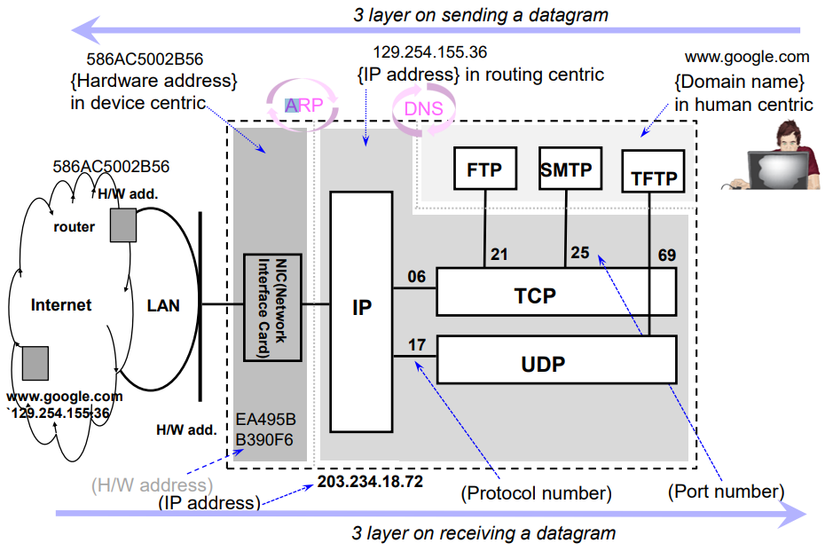
3-layer Internet Addressing

Slide 7
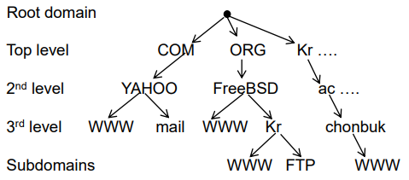
cf) Domain Name
Problem statement
Average brain can easily remember 7 digits
On average, IP addresses have 10.28 digits
So, we need an easier way to remember IP addresses
Makes use of alphanumeric names to refer to hosts
Add a distributed, hierarchical protocol (called DNS)
Address resolution is to map between host names and IP add.
Let’s re-think our DN
www.chonbuk.ac.kr vs www.jbnu.ac.kr

Slide 8
Flow Control
Complex at the transport layer:
Considerable delay in the comm. Of flow control information
The transmission delay may be highly variable, making it difficult to effectively use a timeout mechanism for retransmission of lost data
Reasons for control:
User of the receiving transport entity cannot keep up with the flow
Receiving transport entity itself cannot keep up with the flow of segments

Slide 9
Alternative to Flow Control Requirements
Do nothing
Segments that overflow are discarded
Sending transport entity will fail to get ACK and will retransmit
Thus further adding to incoming data
Refuse to accept further segments from the network service
Relies on network service to do the work
clumsy
Use a fixed sliding widow protocol
With a reliable network service this works quite well
Use a credit scheme
A more effective scheme to use with an unreliable network service

Slide 10
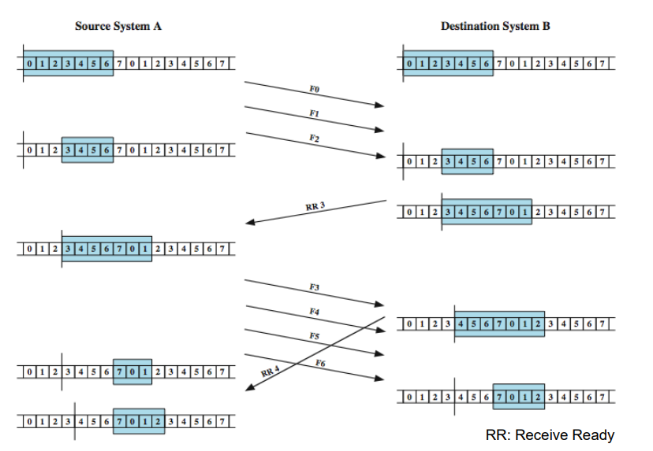
An Example of the Fixed Sliding Window

Slide 11
Credit Scheme
Decouples flow control from ACK
Then, credit scheme mainly rules the flow control
Each octet has sequence number
Each transport segment has sequence number (SN), Ack. Number (AN) and window size (W) in header
Sends sequence number of first octet in segment
ACK includes (AN=I, W=j) which means
All octets through SN=i-1 acknowledged, want I next
Permission to send additional window of W=j octets

Slide 12
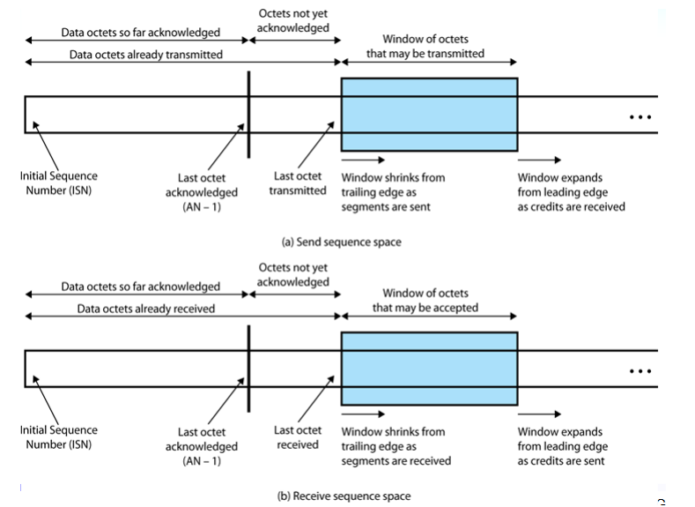
Sending and Receiving Perspectives

Slide 13
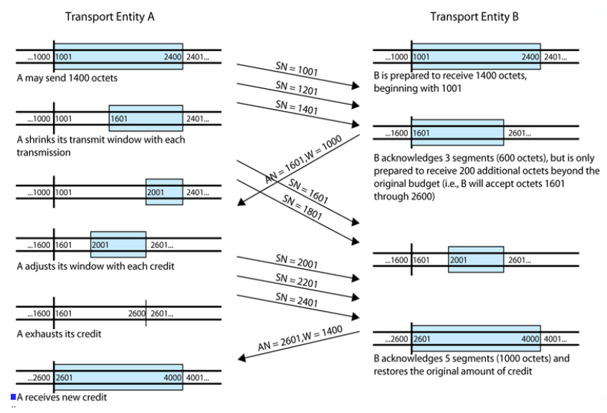
Credit Allocation Mechanism

Slide 14
Connection Establishment and Termination
Serves three main purpose:
Allow each end to assure that the other exists, and the other’s intension to communicate with the initiator
Allows exchange or negotiation of optional parameters
Triggers allocation of transport entity resources
By mutual agreement

Slide 15
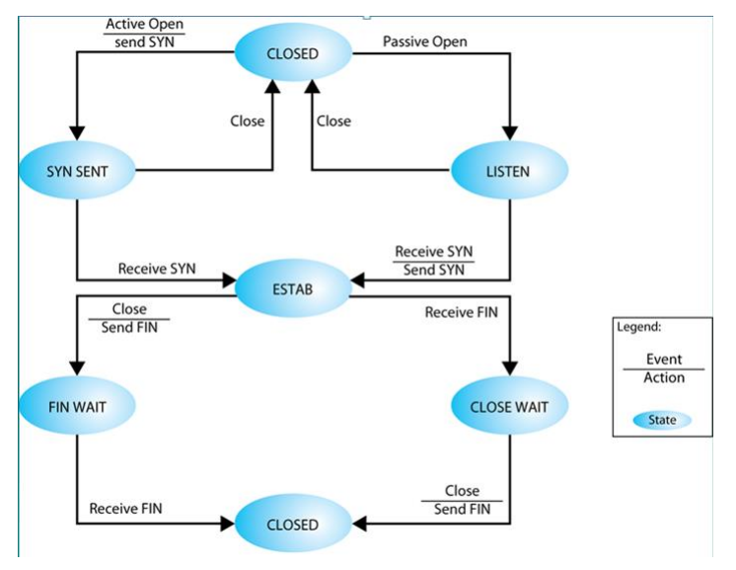
Simple Connection State Diagram

Slide 16
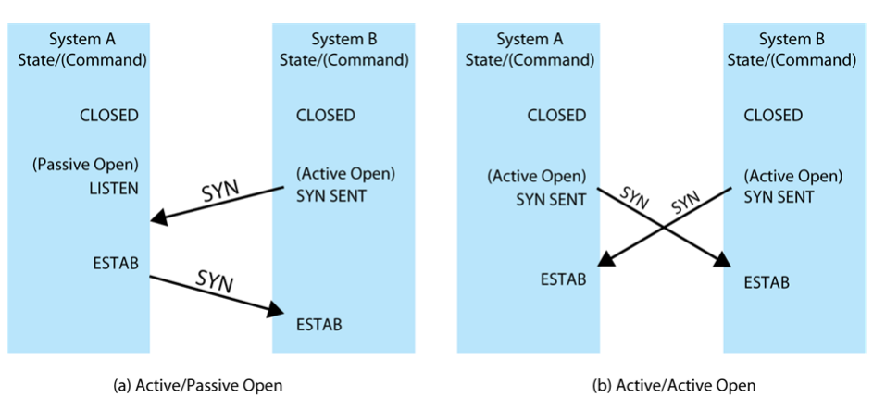
Connection Establishment Scenario

Slide 17
Unreliable Network Service
More difficult case for transport protocol since
Segments may get lost and/or arrive out of order
Examples include
Internetwork using IP
IEEE 802.3 with unacknowledged connectionless LLC service
Issues:
Ordered delivery
Retransmission strategy
Duplication detection
Flow control
Connection establishment & termination
Crash recovery

Slide 18
Ordered Delivery
With an unreliable network service it is possible that segments may arrive out of order
Solution is to number segments sequentially
TCP makes use of a scheme where each data octet is implicitly numbered

Slide 19
Retransmission Strategy
Events necessitating retransmission:
Segment may be damaged in transit but still arrives at its dest.
Segment fails to arrive
Sender does not know transmission was unsuccessful
Receiver acknowledges successful receipt by returning a segment containing an acknowledgement number
Retransmission strategy
No ACK will be issued if a segment does not arrive successfully
A timer needs to be associated with segment at it is sent
If timer expires before acknowledgement is received, sender must retransmit

Slide 20
Duplication Detection
Receiver received a segment, but lost its Ack.
Eventually the sender try to retransmit the segment
Receiver must be able to recognize duplicates
Segment sequence numbers help
Complications arise if:
A duplicate is received prior to the close of the connection
Sender must not get confused if it receives multiple acknowledgements to the same segment
Sequence number space must be long enough
A duplicate is received after the close of the connection

Slide 21
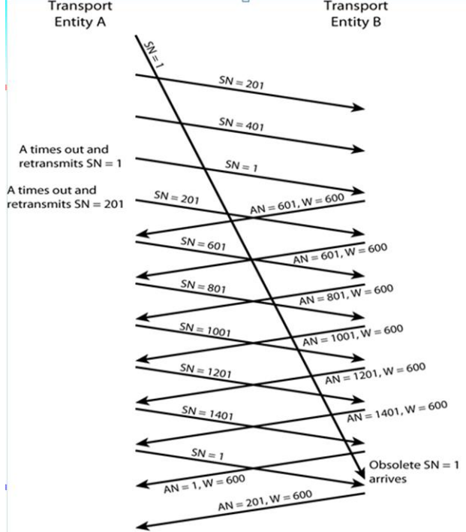
Incorrect Duplicate Detection

Slide 22
Flow Control
Credit allocation quite robust with unreliable network
Can ack data & grant credit
Lost ACK recovers on next received
Have problem if AN=I, W=0 closing window
Then send AN=I, W=j to reopen, but this is lost
Sender thinks window closed, receiver thinks it open
Solution is to use persist timer
If timer expires, send something
Could be re-transmission of previous segment

Slide 23
Connection Establishment
Two way handshake
A send SYN, B replies with SYN
Lost SYN handled by re-transmission
Ignore duplicate SYNs once connected
Lost or delayed data segments can cause connection problems
With data segment from old connections
Make use SYN i, where i is the sequence # of the first data
Start segment # far removed from previous connection
There is still a problem with SYN segment from old connections
Need ACK to include i
So, three way handshake

Slide 24
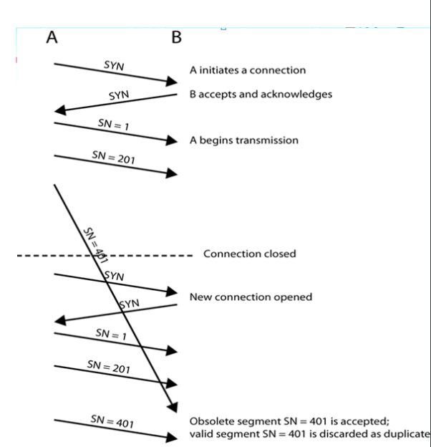
Two Way Handshake problem with Obsolete Data Segment

Slide 25
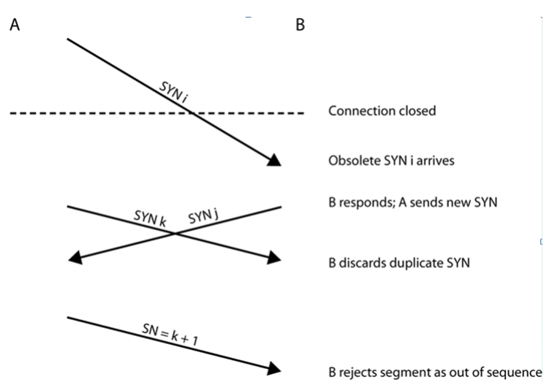
Obsolete SYN Segment

Slide 26
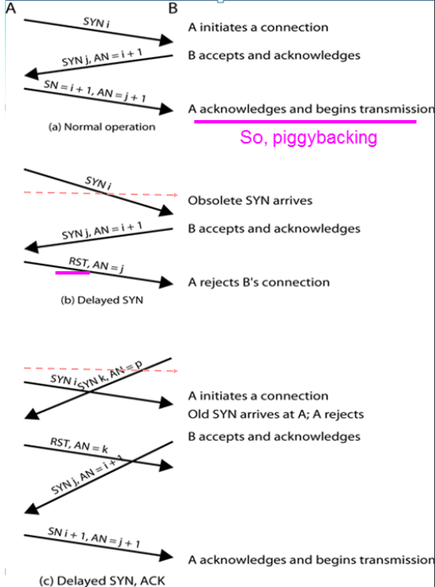
Three Way Handshake : Examples

Slide 27
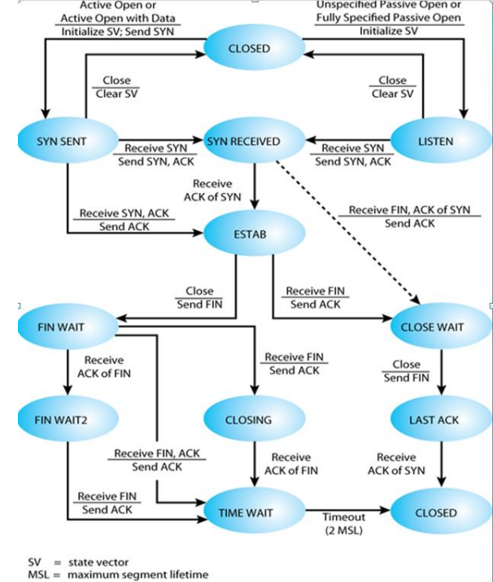
TCP Entity State Diagram

Slide 28
Connection Termination
2-way handshake is inadequate on an unreliable network
Like connection establishment, it need 3-way handshake
Out of order segments could cause:
The FIN segment to arrive before the last data segment
To avoid this problem the next sequence number after the last octet of data can be assigned to FIN
Each side must explicitly acknowledge the FIN of the other using an ACK with the sequence number of the FIN to be acknowledged

Slide 29
Failure Recovery
After restart a system, the state information of all active connections is lost
May have half open connection because side that did not crash still thinks it is connected
Still active side of a half-open connection can close the connection using a keepalive timer
Wait for ACK for (time out) * (number of retries)
When expired, close connection and inform user
Or, failed side returns an RST i to every segment i that it receives
RST i must be checked for validity on the other side
If valid, an abnormal termination occurs

Slide 30
TCP Services
TCP (Transmission Control Protocol) : RFC 793
Connection oriented, reliable communication over reliable and unreliable (inter)networks
Two ways of labeling data:
Data stream push
User requires transmission of all data up to push flag
Receiver will deliver in same manner
Avoids waiting for full buffers
Urgent data signal
Indicates urgent data is upcoming in stream
User decides how to handle it

Slide 31
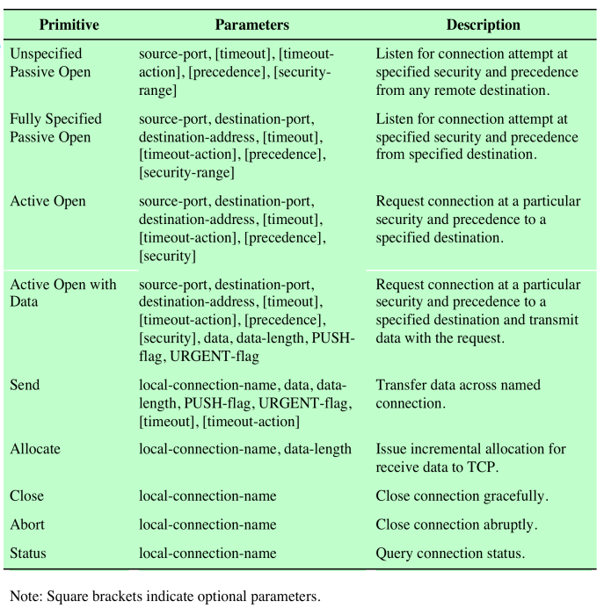
TCP Services Request Primitives

Slide 32
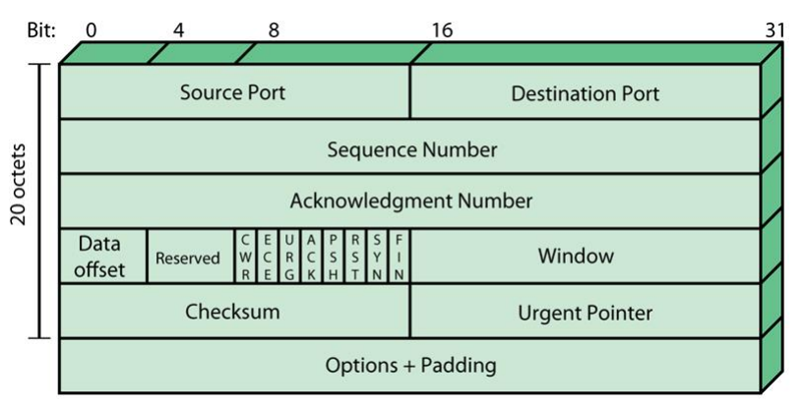
TCP Header Format

Slide 33
TCP Mechanisms
Can be grouped into:
connection establishment
Always uses a three-way handshake
Connection is determined by host and port
Data transfer
Viewed logically as consisting of a stream of octets
Flow control is exercised using credit allocation
Connection termination
Each TCP user must issue a CLOSE primitive
An abrupt termination occurs if the issues an ABORT primitive

Slide 34
TCP Implementation Policy Options (1)
Send policy
If no pushed data, a sending TCP entity transmits at its own convenience in credit allocation
May construct segment per batch of data from user : quick response but higher overheads
May wait for certain amount of data : slower response but lower overheads
Deliver policy
In absence of push, can deliver data at own convenience
May deliver from each segment received : higher O/S overheads but more responsive
May buffer data from multiple segments : less O/S overheads but slower

Slide 35
TCP Implementation Policy Options (2)
Accept policy
If segments arrive out of order the receiving TCP entity has two options:
In-order
Accept only segments that arrive in order; any segment that arrives out of order is discarded
Makes for simple implementation but places a burden on the networking facility
If a single segment is lost in transit, then all subsequent segments must be retransmitted
In-window
Accept all segments that are within the receive window
Requires a more complex acceptance test and a more sophisticated data storage scheme

Slide 36
TCP Implementation Policy Options (3)
Retransmit policy (three strategies)
First only
Maintain one retransmission timer for entire queue
If timer expires, retransmit the segment at the front of the queue
Efficient traffic generation, but can have considerable delays
Batch
Maintain one retransmission timer for entire queue
If timer expires, retransmit all segments in the queue
May result in unnecessary retransmissions

Slide 37
TCP Implementation Policy Options (3)
Individual
Maintain one timer for each segment in the queue
More complex implementation

Slide 38
TCP Implementation Policy Options (4)
Acknowledge policy (timing of ack.)
Immediate
Immediately transmit an empty segment containing the appropriate acknowledgment number
Simple and keeps the remote TCP fully informed
Limits unnecessary retransmissions
Can cause a further load on the network
Cumulative
Wait for an outbound segment with data on which to piggyback the acknowledgement
Typically used
Requires more processing at the receiving end and complicates the task of estimating round-trip time

Slide 39
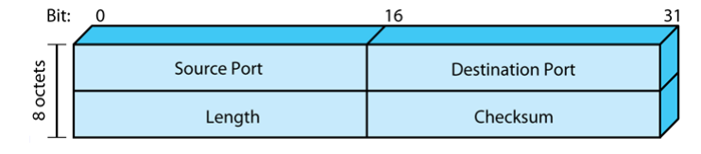
UDP
Connectionless service specified in RFC 768
Delivery & duplication control not guaranteed
Reduced overhead in transmission
Least common denominator service
Uses:
Data collection & dissemination
Request-response
Real time application

